Slide 1

Linear Motion Mechanisms
Team 13380
QUANTUM STINGERS

Slide 2
Linear Motion Mechanisms
Linear Motion is defined as motion in a straight line, as opposed to the circular motion produced by motors
There are many scenarios in FTC where linear motion is essential, and there are also many different mechanisms that can produce linear motions
The main mechanisms include
Rack and Pinion
Linear Actuator
Scissor Lifts
Linear Slides
In this presentation, we’ll go over each mechanism, their pros and cons, and where they should be used

Slide 3
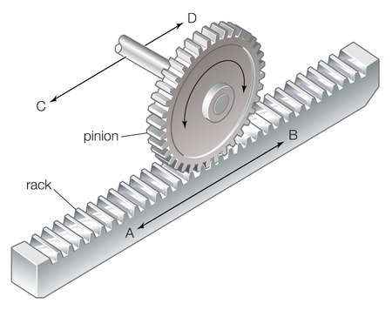
Rack and Pinion
The rack and pinion mechanism works by using a pinion (gear) which is attached to your motor to move a rack.
Turning the gear allows the rack (attached to the extending piece) to move
Advantages
Very Reliable when used for small movements
As it runs on a gear system, it can make precise movements very consistently
The system is strong, and can be used in places where high torque is needed
Powered in both directions of movement
Disadvantages
Bulky and heavy
Has a very limited range of motion
Not many different models for FTC usage available on the market
Racks are made of plastic and can break under too much pressure

Slide 4
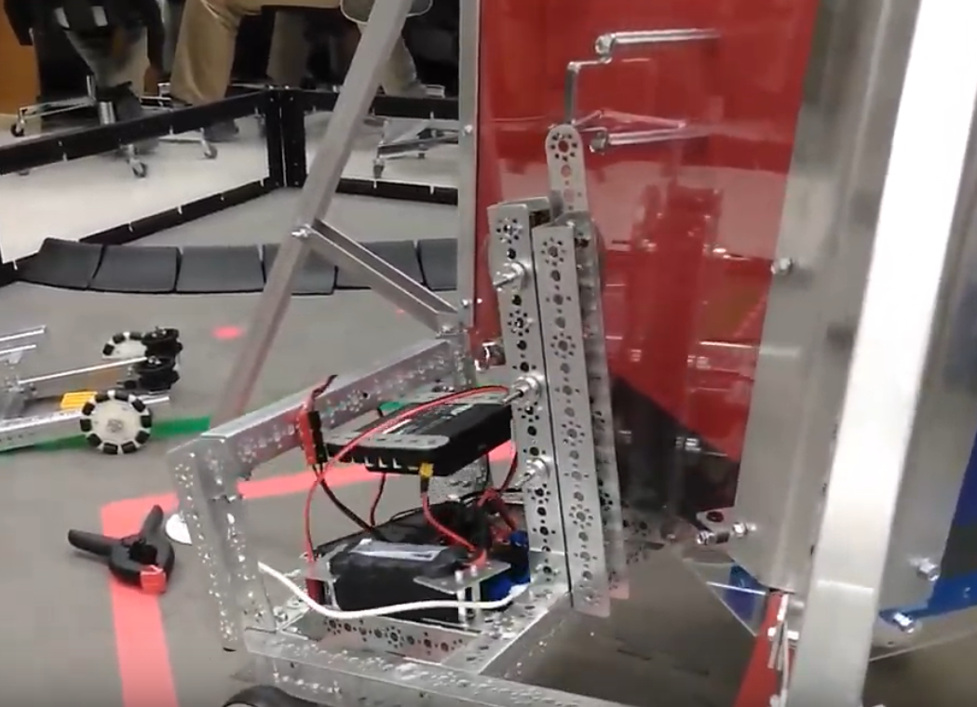
Rack and Pinion
Ideal situations
The rack and pinion mechanism should be used for short movements where a job must be done consistently
It can be used in places where high torque but not too much extension is needed
Here is an example of a robot that uses a rack and pinion.
This robot is using the rack and pinion system to lift itself up 6 inches, displaying an ideal situation where it can be used.
(Rover Ruckus Challenge)
The Tetrix Rack and Pinion System can be purchased at: https://www.pitsco.com/TETRIX-Rack-and-Pinion-Linear-Slide-Pack

Slide 5
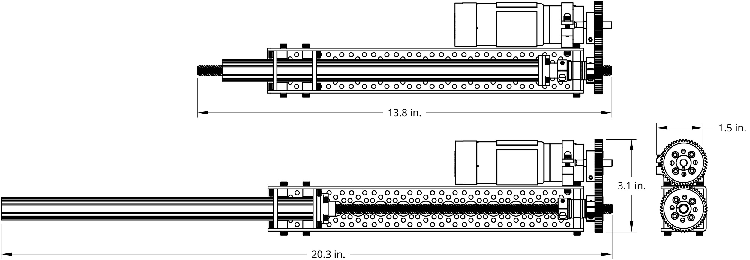
Linear Actuators
Linear Actuators work using a lead screw. This lead screw works with a metal bar that extends outwards, forming a screw to bolt relationship.
When the lead screw spins, the bolt either tightens or loosens, just like a bolt would in real life, causing the bolt (Metal bar) to travel up or down.
Advantages
This system offer by far the most torque
The system is very reliable
Due to the friction on the lead screw, linear actuators can only move downwards when the motor spins, no matter how much force is put on it, which can be very useful when something must hold its position under duress or if the motor is not powered
Disadvantages
Linear Actuators are very slow
There is only one model that is FTC legal and available for teams

Slide 6
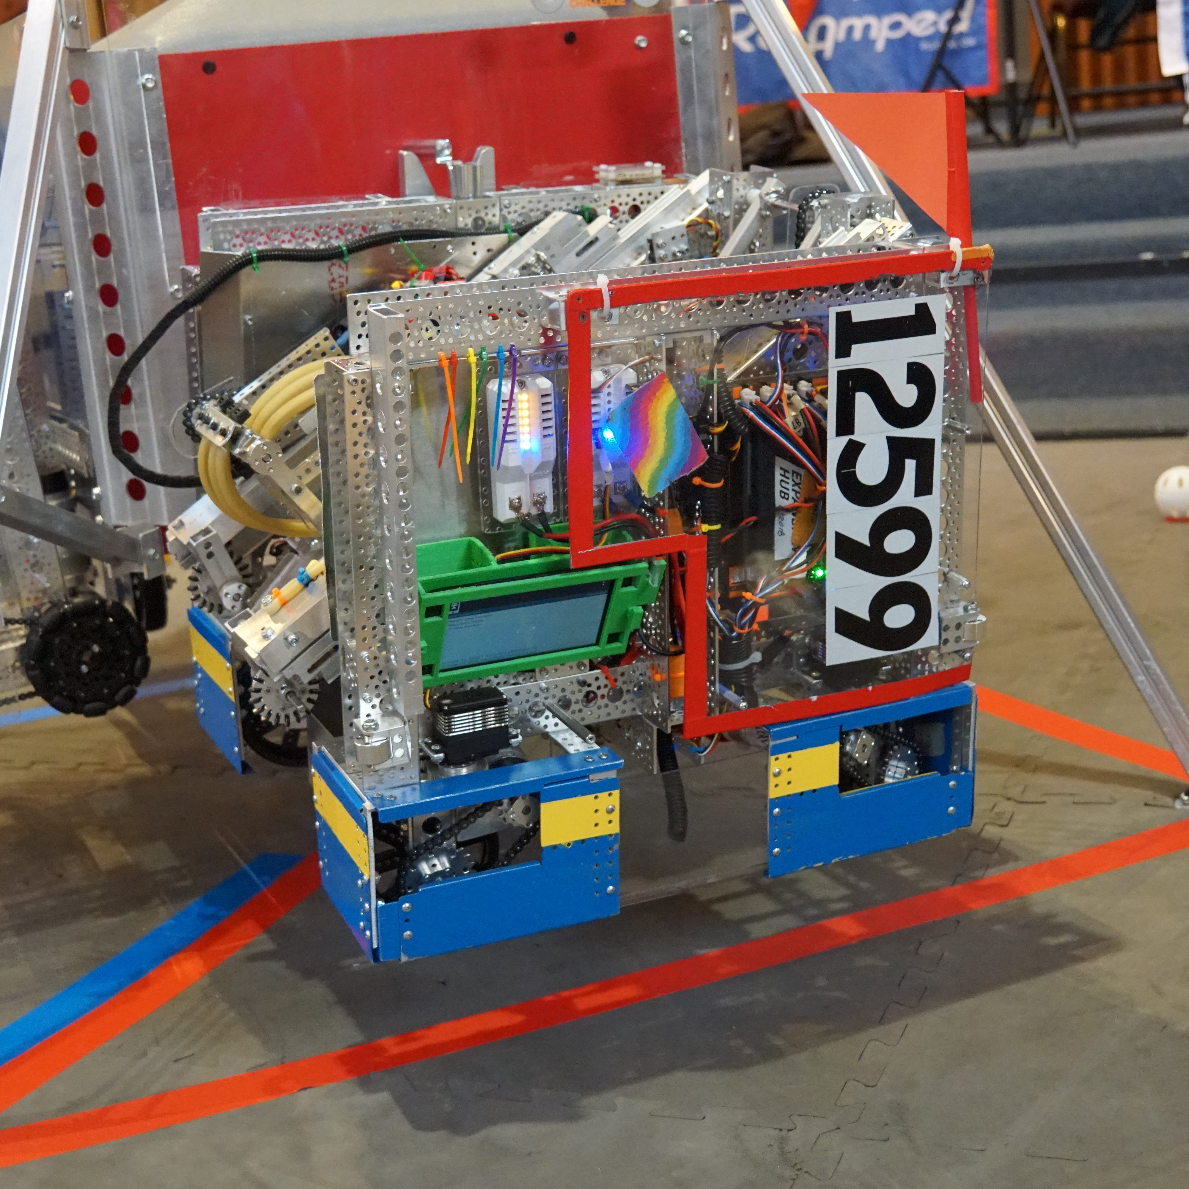
Linear Actuators
Ideal situations
The linear actuator system should be used in scenarios where power is of the utmost importance, but speed is not
Here is an example of a robot that uses a linear actuator.
This robot is using the mechanism to lift itself up 6 inches, just like the robot displayed previously. This team used a linear actuator instead of a rack and pinion as linear actuators give more torque, so could be used to lift up heavier robots
The ServoCity linear actuator system can be purchased at: https://www.servocity.com/linear-actuator-kit-7-4-stroke-6-0-sec

Slide 7
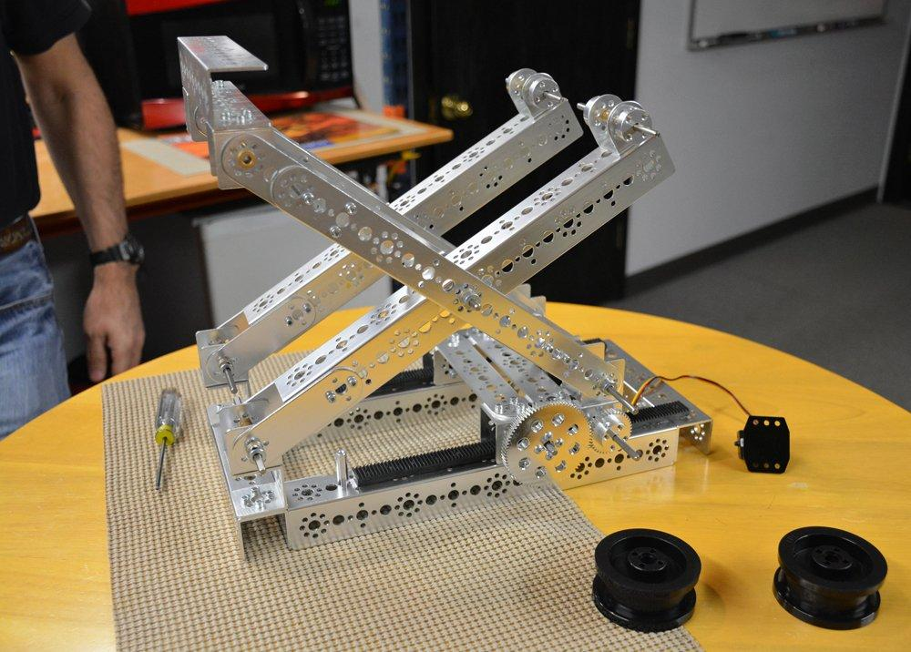
Scissor Lifts
Scissor lifts are operated by either a rack and pinion or lead screw, which contract the scissor legs, causing upwards linear movement
One scissor leg is stationary, while one scissor leg is attached to the rack and pinion/lead screw.
Advantages
Scissor lifts are high torque
They can go very long distances
Can be built to move very fast
Disadvantages
Significantly harder to build correctly than other mechanisms
Not many kits available

Slide 8
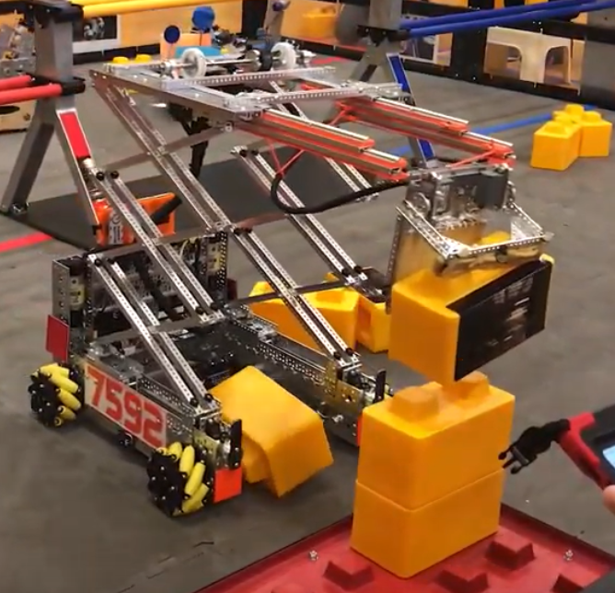
Scissor Lifts
Ideal situations
The scissor lift should be used in situations where you need to move long distances and space is not the biggest concern
Here is an example of a robot that uses the scissor lift
This robot is using the mechanism to stack 8 inch tall blocks in a stack of at least 5.
The scissor lift was effective here as it can go very high at a fast speed.
(SkyStone Challenge)

Slide 9
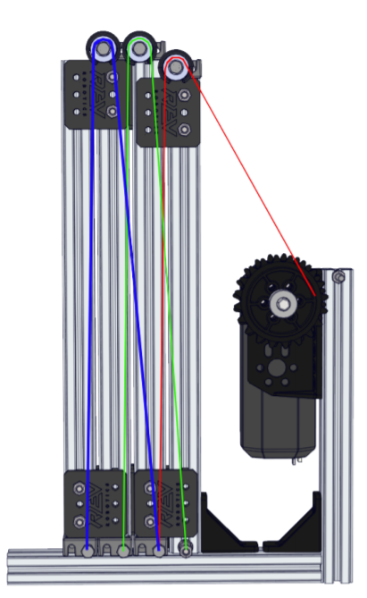
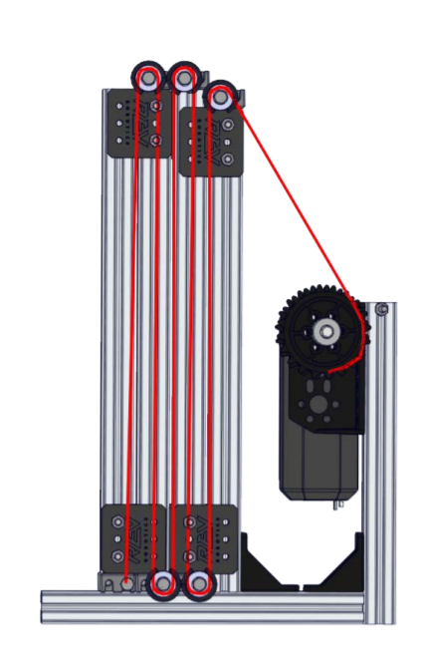
Linear Slides
Linear slides work using a system of strings going stage to stage in a zig zag pattern. When the string is pulled, the stages will go up to compensate for the lost string.
Advantages
There are many available linear slide building kits
Linear slides are fast and reliable
They are compact, and you can add as many slides as needed to go up any target length
Disadvantages
They are only powered in one direction of motion. They can only go up, and you must use either surgical tubing or a second string to bring them down
Linear slides are not the strongest mechanism
There are 2 types of stringing for linear slides, each with their own advantages and disadvantages
Elevator Stringing (Pictured on the right)
Cascading Stringing (Pictured on the left)

Slide 10
Elevator vs Cascading
Elevator stringing
This stringing method is simpler and only one slide moves at a time
Since only one string is moving at a time, it is slower than cascading stringing
Allows for much more precise movements
Cascading Stringing
Each slide is strung to another slide, so when one moves they all move.
Since every slide is moving at the same time, it requires much more energy than elevator stringing
While much faster, it is harder to make precise and controlle movements

Slide 11
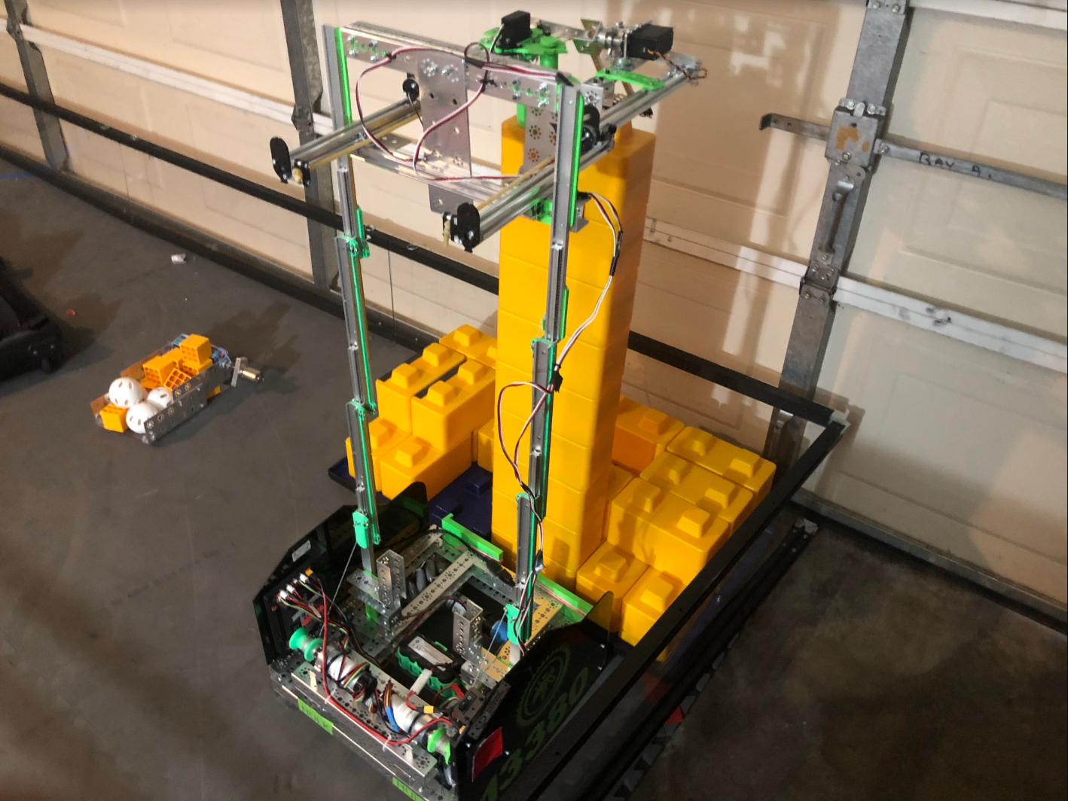
Linear Slides
Linear slides in general can be used anywhere that linear motion is required, but extreme power is not. They are the most versatile of the mechanisms and can be used almost everywhere
Our team used linear slides in our robot to be able to stack up to 8 stones quickly and efficiently.
As the stones were not very heavy and we did not have the space for a scissor lift, this was an ideal scenario where linear slides could be very useful.
(SkyStone Challenge)

Slide 12

Credits
This lesson was written by Louis Law and Dhruv Gupta for FTCTutorials.com
You can contact the author at dhruv.gupta@norcalrobotics.org
More lessons for FIRST Tech Challenge are available at www.FTCtutorials.com
This work is licensed under a
Creative Commons Attribution-NonCommercial-ShareAlike 4.0 International License.

